Slide 1
FuelUp
CSCC10
By: Energy Moguls

Slide 2
The Scenario: Some Common Cases
The GTA Commuter:
Long commute (Distance and time)
Passes a dozen stations on the way to work
Gas lines are unpredictable
And Others:
Gas stations in unfamiliar cities
Amenity uncertainties
Price differences!
EV charging!!

Slide 3
The Solution:
FuelUp
Features include:
Map of gas stations
Fuel grade filters
Amenities information
EV charging spots
Live wait times!
All your fuel needs in one app!

Slide 4
Phase I
Project Proposal

Slide 5
Audience
FuelUp Targets…
DRIVERS
Any and all within driving age!
Most useful for:
Daily commuters
Road-trippers
Drivers in foreign cities

Slide 6
What does the literature say?
Poverty => 9% of income on fuel
FuelUp can help you save what little there is to save
Poverty => Inconsistent EV charging spots
Hard to find chargers? Not anymore with our map
Competition in price => Consumers trying to find the best price
When differences are great, users will want an app like this
Encouraging findings for the team!
FuelUp can make a difference

Slide 7
Phase 2: Overview
Personas, Scenarios and HTA tasks.
Data gathering techniques.
Results and Analysis.

Slide 8

Why?
Our Targeted Users… Drivers!
Personas
Ages 16-19.
Ages 20-29.
Ages 30-39.
Ages 40-60.
Source: https://www.lastpodcastnetwork.com/blog/2019/6/29/the-four-stages-of-life

Slide 9
Common User FAQs:
Can I explore fuel stations?
Is there a way to see current, real-time fuel types and prices?
What about amenities?
Filtering?
… and more?!
Yes!
Yes!
Yes!
Yes!
See a trend?

Slide 10

Data Gathering
Interviews (12 total)
Google Form Survey
For C10

Slide 11
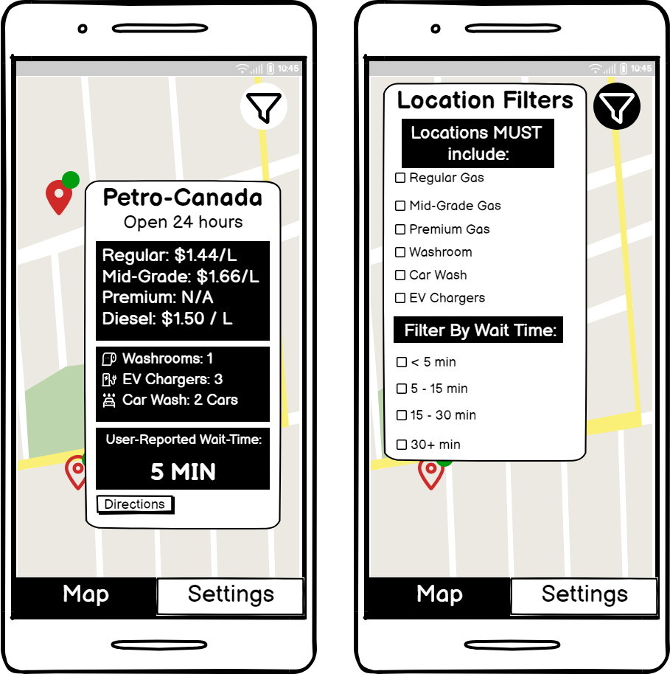
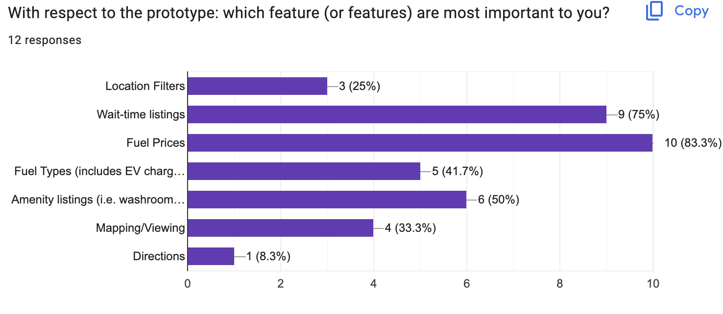
Prices
Conveniency

Slide 12
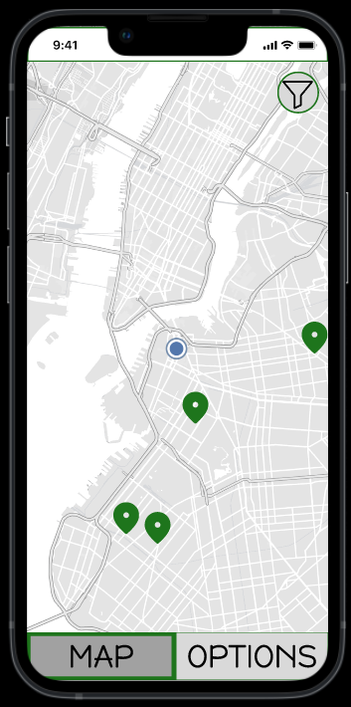
Phase III
Interactive Prototype

Slide 13
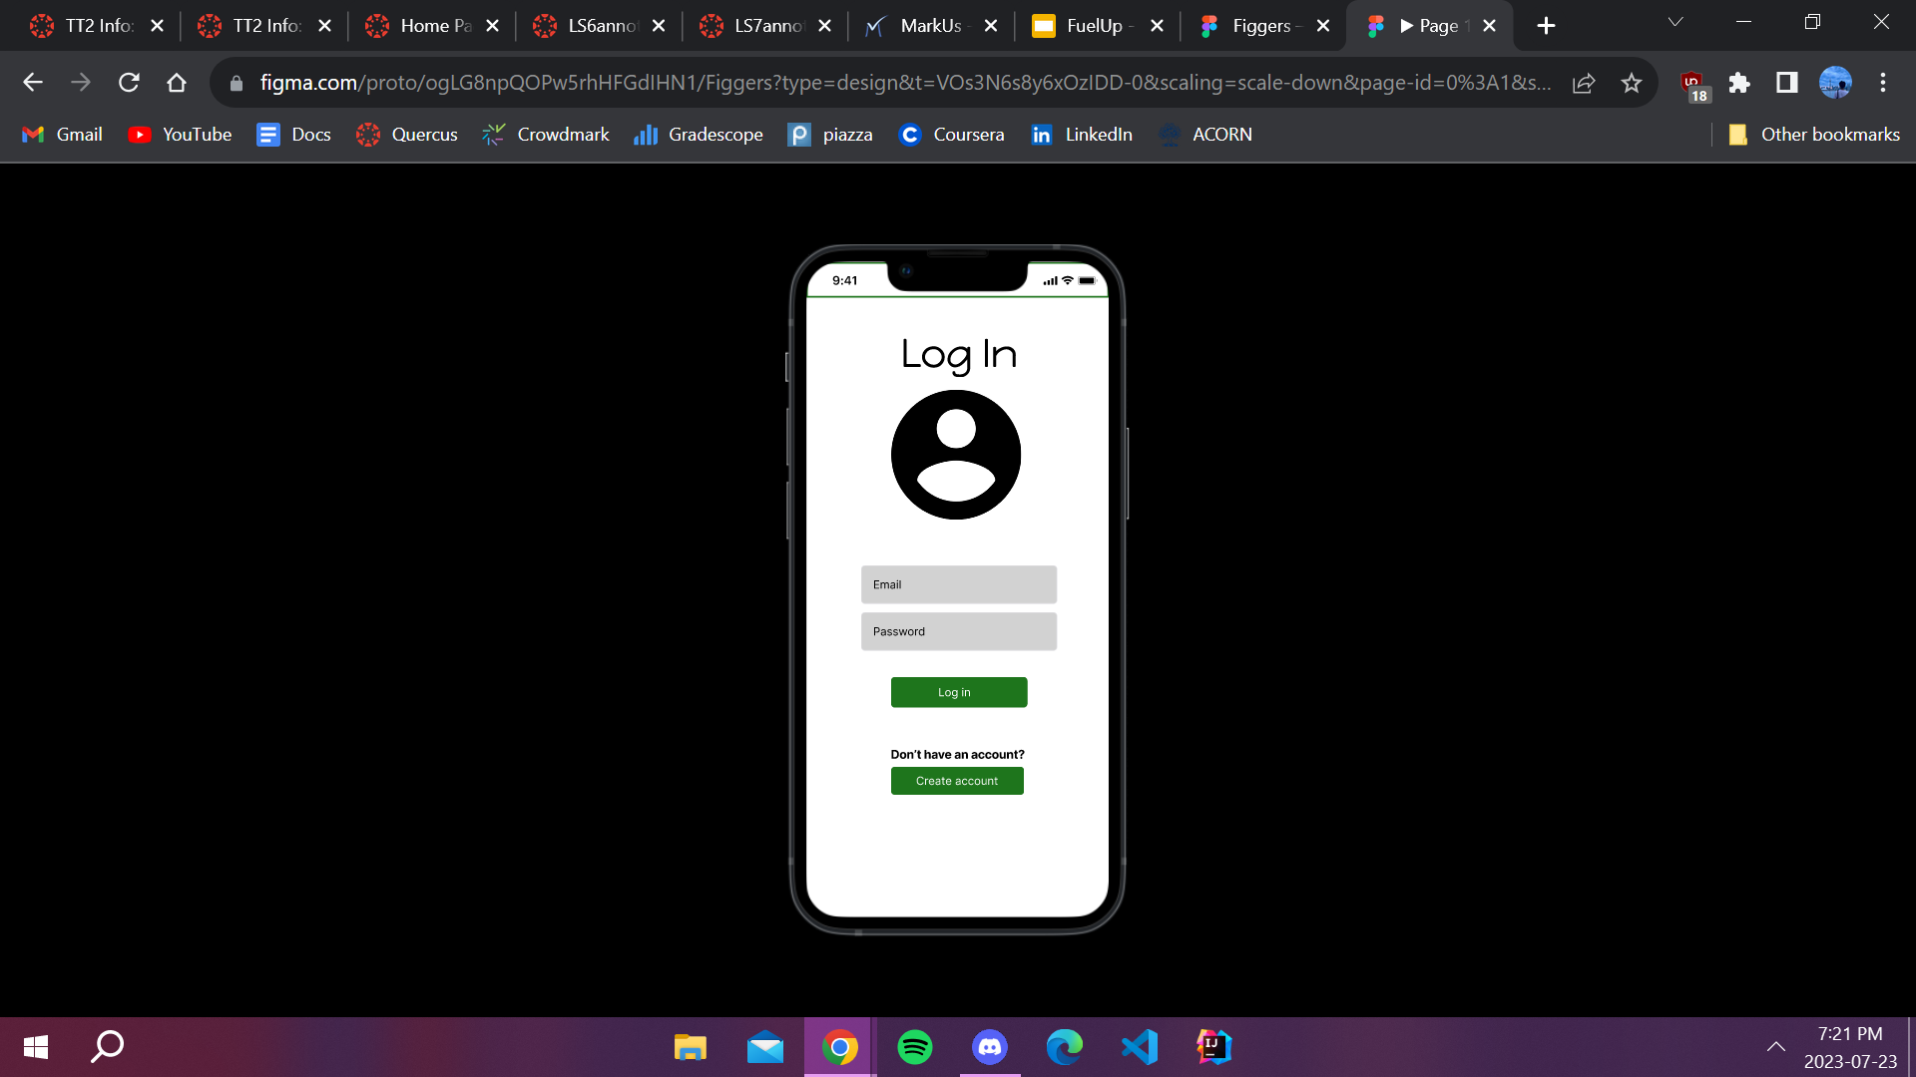
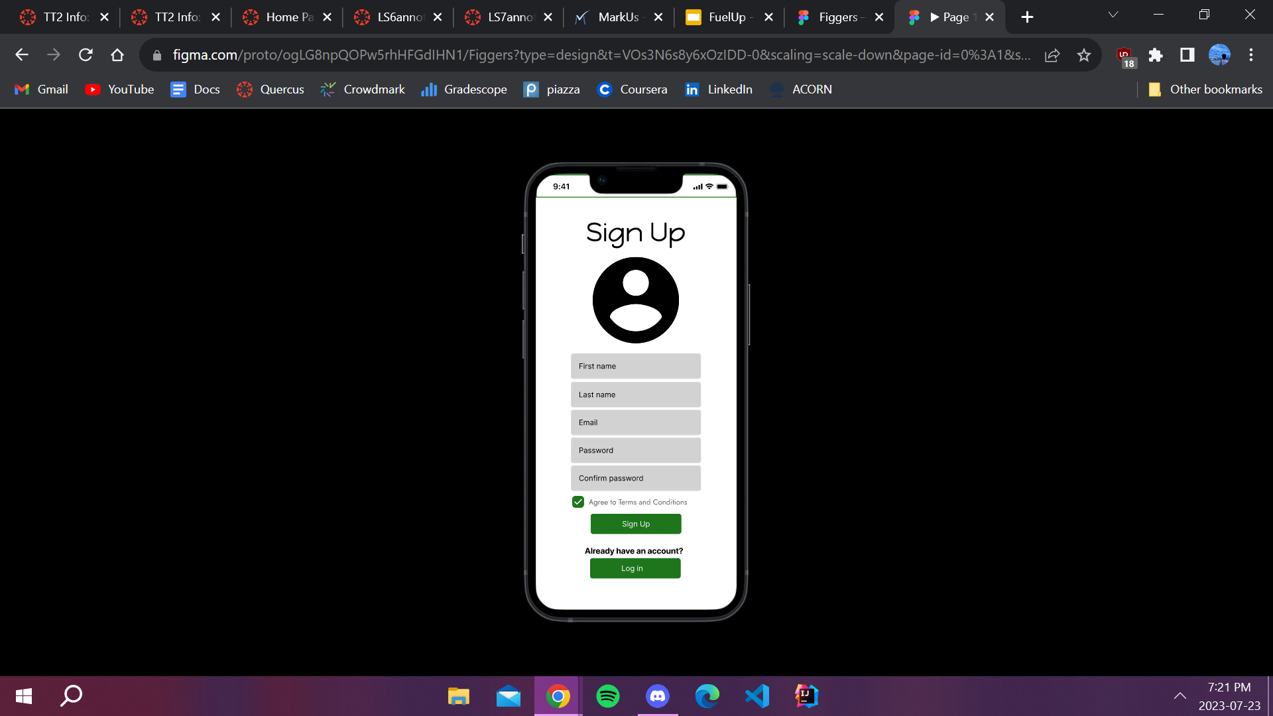
Account Management
Login Page
Email
Password
Sign Up Page
Name
Email
Set & Confirm Password
Agree to Terms and Conditions

Slide 14


Home
Home Page
Map View
Current Location (Blue Circle)
Surrounding Gas Stations (Location Pins)
Filter (Top Right)
Options Button

Slide 15
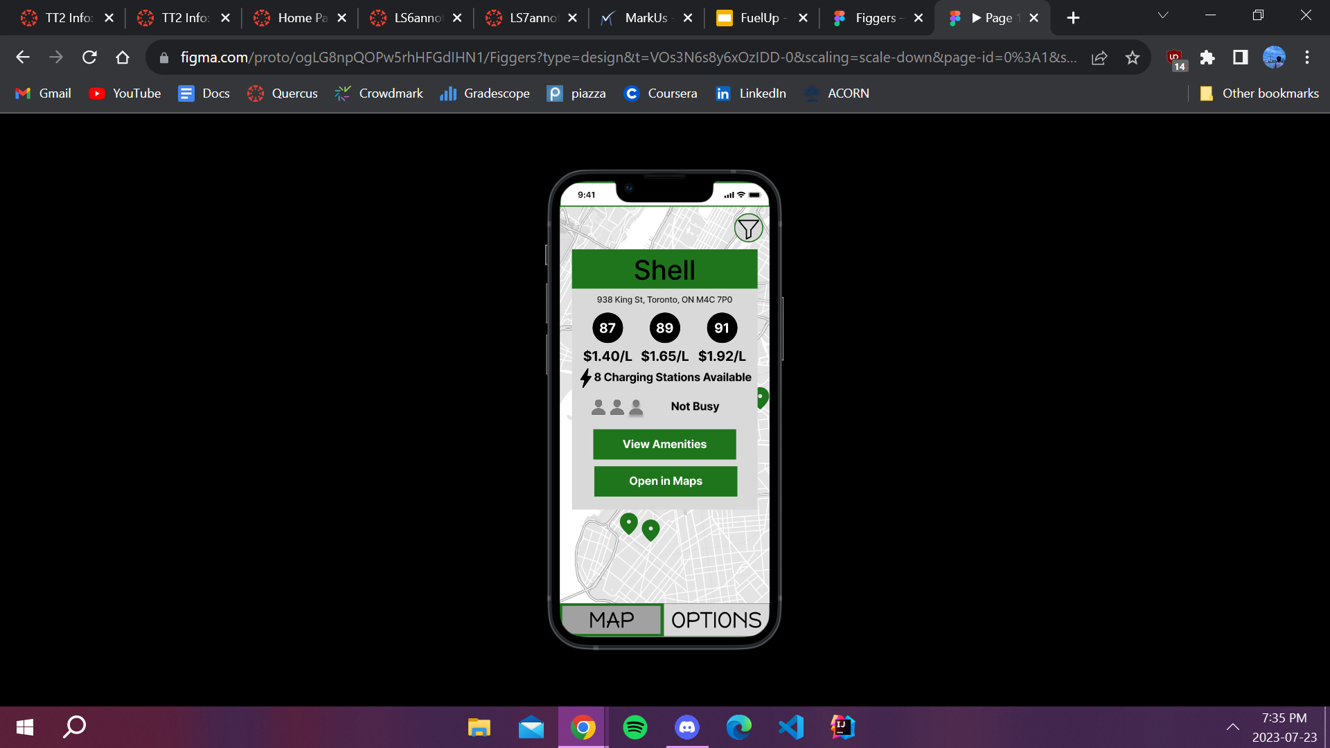

Exploring Fuel Prices
How to Find Prices?
Click on any location pin
Gas station information will pop up
View types of fuel offered at this station
View the prices associated with each grade

Slide 16
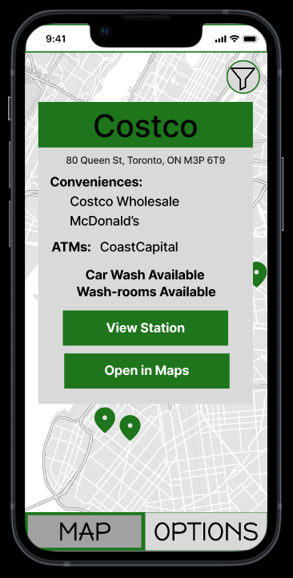
Discovering Amenities
How to Find Amenities?
Click on any location pin
Gas station information will pop up
Select “View Amenities”
Browse offered amenities

Slide 17
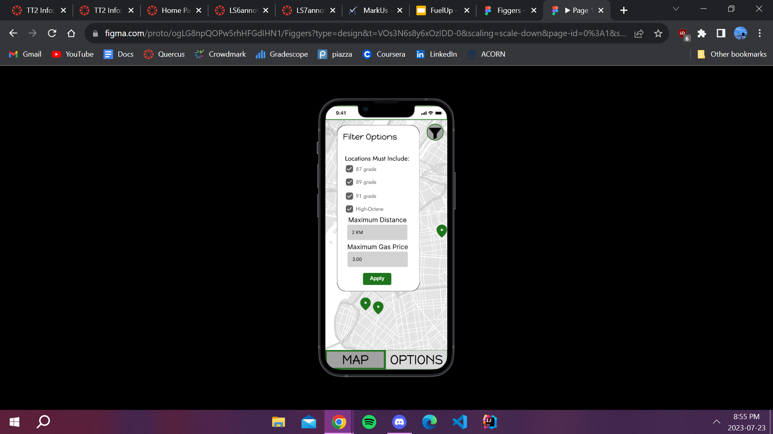
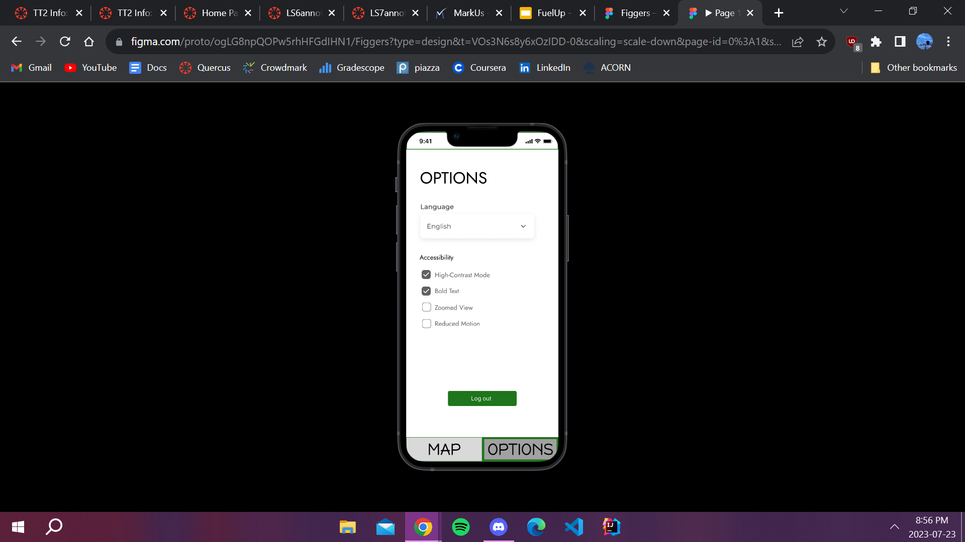
Filtering and Setting Options
How to Filter Gas Stations?
Click on “funnel” icon located at top right of screen
Select fuel types (if desired)
Enter max distance (if desired)
Enter max price (if desired)
Click “Apply”
Only satisfying gas stations would show on map

Slide 18
Filtering and Setting Options
How to Set Preferences?
Click on “Options” button located at bottom right of screen
Open drop down menu to switch language (if desired)
Select or deselect from list of accessibility options (if desired)
Changes will automatically be applied upon selection

Slide 19
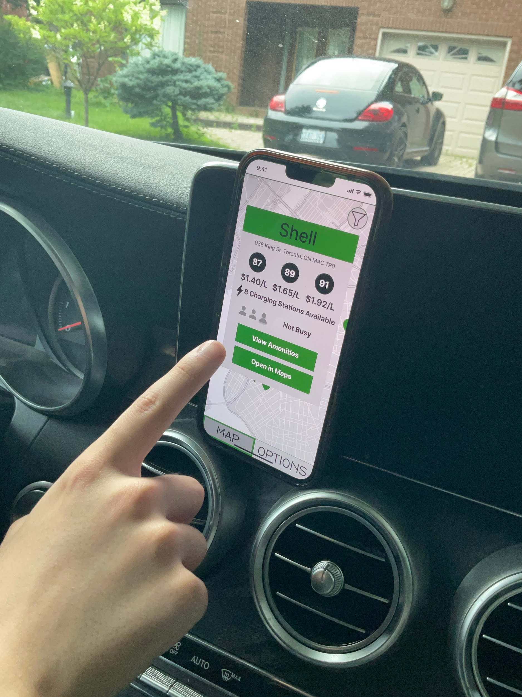
Phase IV
Usability Evaluation & Interviews

Slide 20
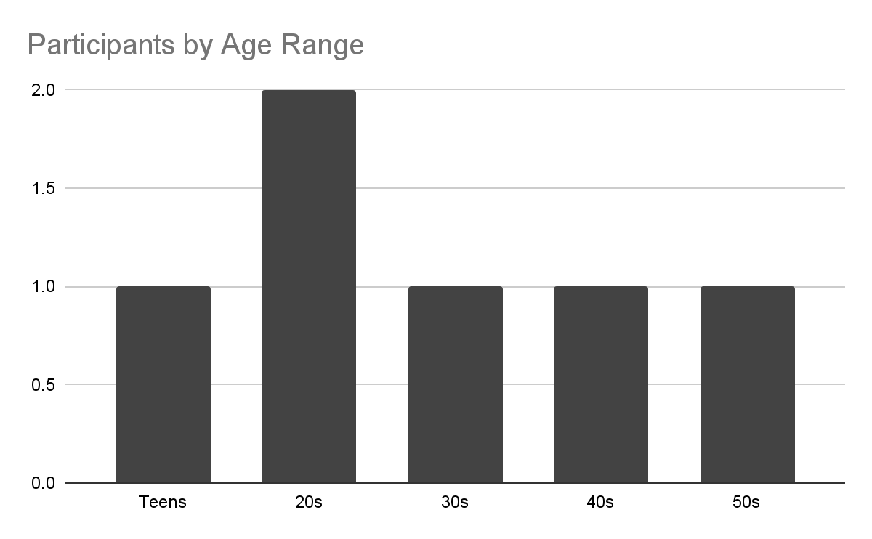
Interviews
Real Setting in Participant’s Vehicle
3 Participants
Online via Zoom
3 Participants

Slide 21
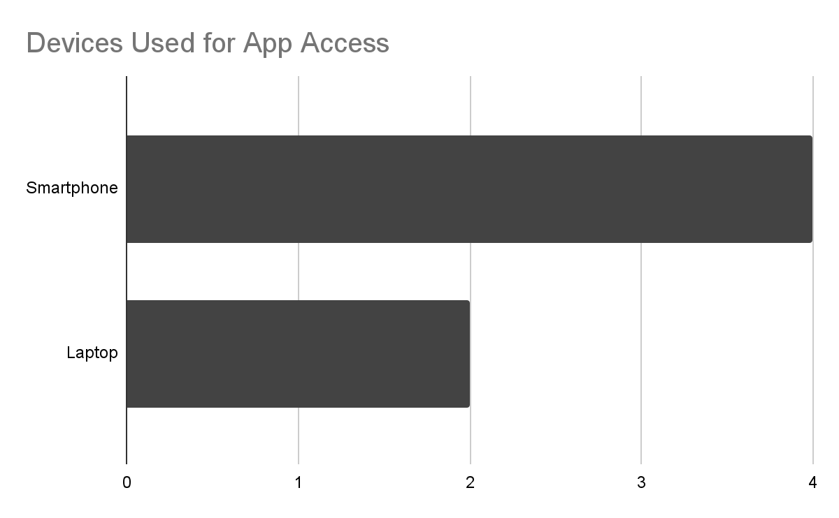
Interviews
Real Setting in Participant’s Vehicle
3 Participants
Online via Zoom
3 Participants

Slide 22
Interviews
Procedure
Obtain consent for the interview
Ask for self evaluation in technical abilities prior to exposure to app (Out of 10)
Describe the purpose and specification of FuelUp
Allow participant to explore app freely for 15 minutes and ask them to say out loud any opinions they would like to share
Assign tasks for the participant to complete (Around 10)
Ask for overall satisfaction of the app and would they consider using the app
Close off interview by thanking the participant for their time
Usability Evaluation & Interviews

Slide 23

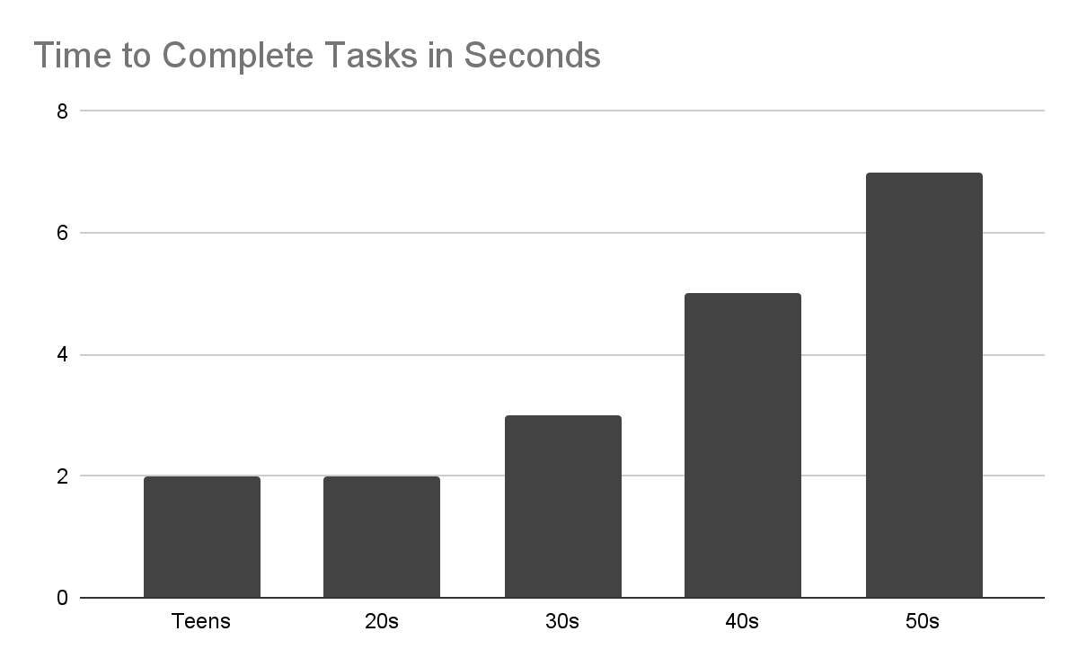
Results
Efficiency
Exponential with respect to age

Slide 24
Results
Common Errors
Teen: Navigation error with closing amenities page
20s: Forgot where to log out
30s: Invalid filter option entry
40s: Redirected to maps when trying to open amenities
50s: Misinterpreting functions

Slide 25
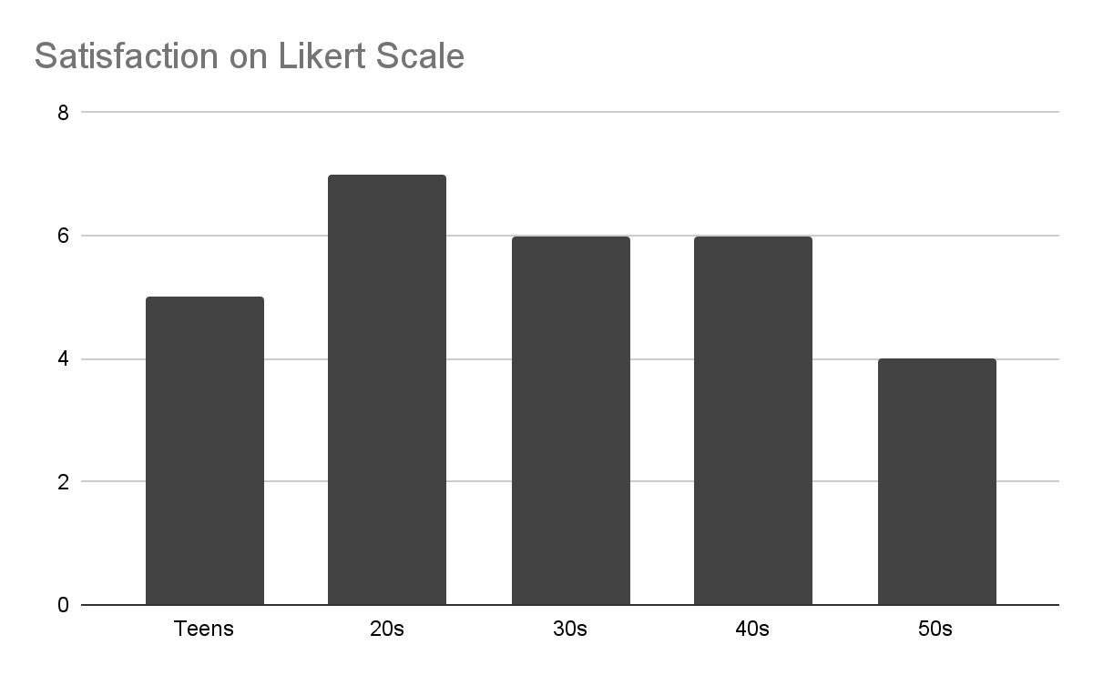
Results
Satisfaction
Average: 5.8/7
High: 7/7
Low: 4/7

Slide 26
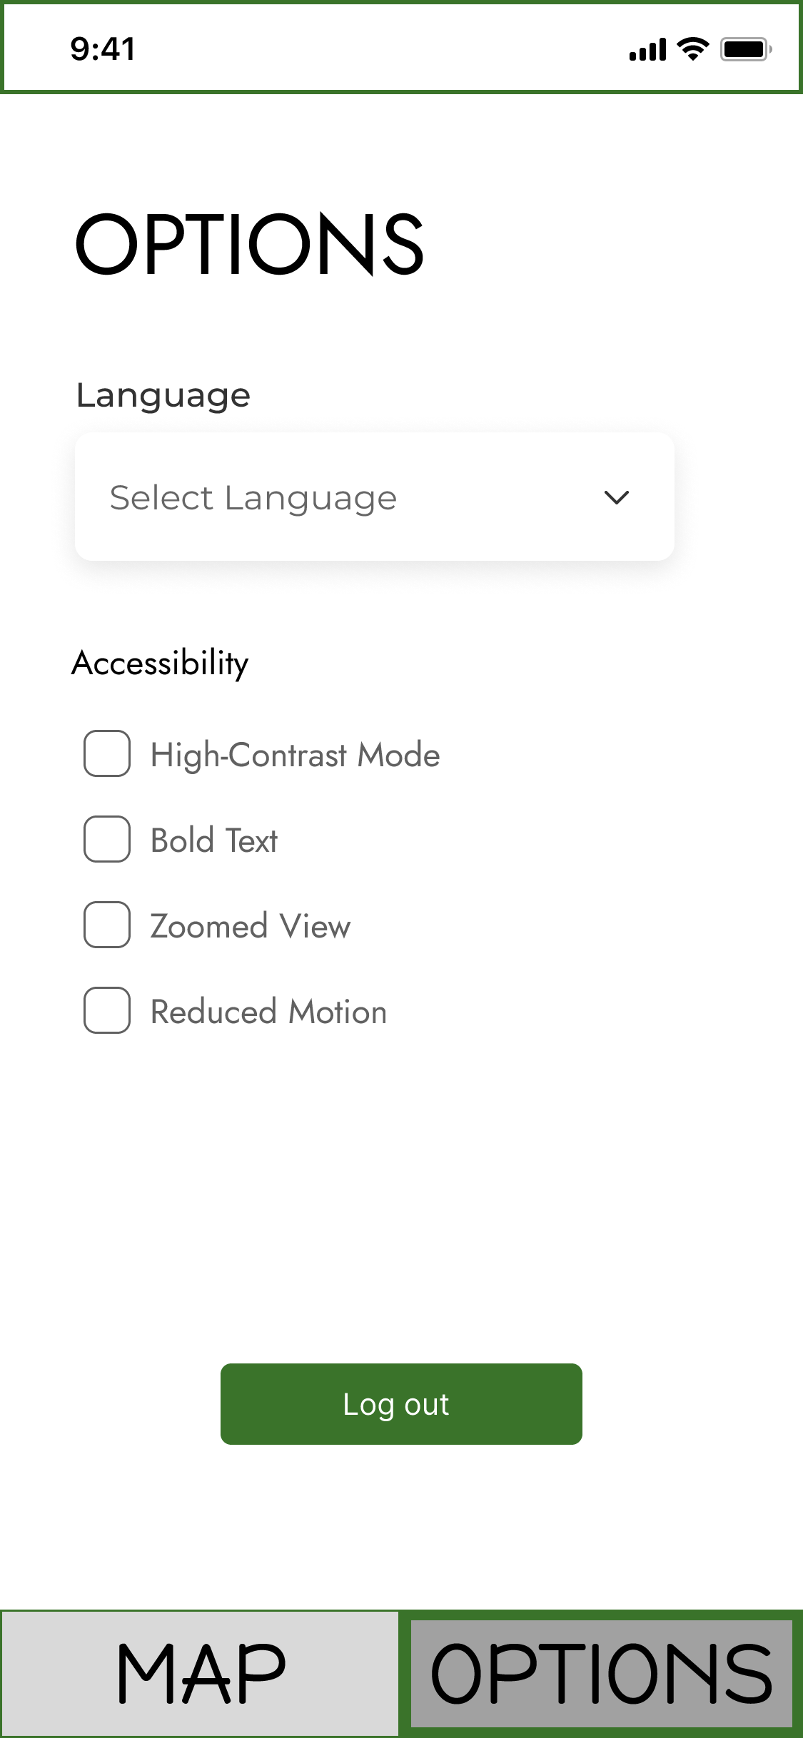
Limitations
Technical Limitations
Selection feature works on web app but does not work on Figma mobile
Occasional black screens and crashes occur that irritates the participant
Produces a negative impression on our design

Slide 27
Limitations
Design Limitations
Inconsistency caused slow down and confusion in certains tasks
No help and documentation page for users to refer when
Lack customization options to keep user in control

Slide 28
Limitations
Design Limitations
Inconsistency caused slow down and confusion in certains tasks
No help and documentation page for users to refer when
Lack customization options to keep user in control

Slide 29

Future Changes
Ways to Combat Limitations:
Offer consistent design and functionality to promote efficiency and memorability
When the user first registers for the app, they will be offered an optional walk through in addition to a help and documentation they can later refer to
Offering options for users to customize app beyond accessibility options to keep users in control

Slide 30
Conclusion
FuelUp: one less worry for your day.
Convenient, informative, personable.
For drivers: anyone, anywhere, anytime.
Is it perfect? No, but part of the process.

Slide 31
Aaliyah Jaleel (jaleelaa)
Alex Zeng (zengwe11)
Jeremy Neilson (neilso14)
Neil Wang (wangnei3)
Sana Alia (aliasana)
Xiaoran Yu (yuxiaor2)
Q & A

